Slide 1
Interactive Student Notebooks
Organizational System and Requirements

Slide 3
Why use an ISN?
Organization
All your materials for class are in 1 place
Personalized learning
Different learning styles
Identify daily objective
Acquisition of information (right side)
Application of information (left side)
Synthesis of information (summary)

Slide 4
Required Materials for ISN
8.5x11 spiral notebook (Mead 5 star)
Fits full size sheets of paper
Colored pencils or crayons (NO MARKERS)
Glue sticks to attach papers
Highlighters

Slide 5
Parts of the ISN
Title page
Table of contents
Right side – teacher or “input” side
Left side – student or “reflection” side
Summary – 1 paragraph synthesizing the information you learned from the lesson.
NOT a retelling of daily activities

Slide 6
Title Page

Slide 7
Table of Contents

Slide 8
Right Side
Objective (TSW), title, and date
Organized set of information for all students provided by the teacher.
Testable information
Examples
Notes
Guided readings
Vocabulary
Video questions
Primary documents and analysis worksheets
Other teacher assigned work

Slide 9
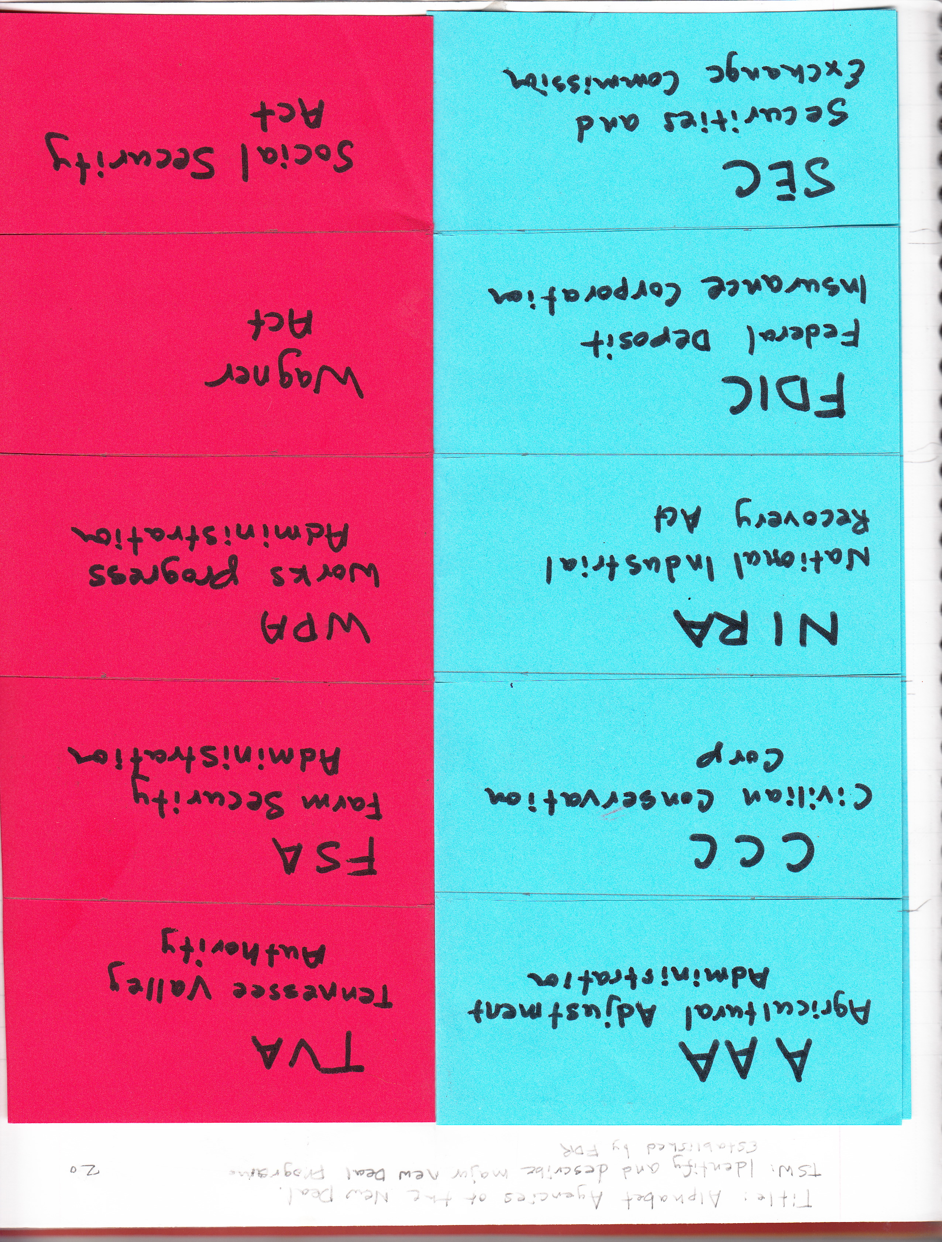
Right Side Examples

Slide 10
Left Side
Student side
Student generated work that represents the main idea or objective of the lesson.
Examples:
Illustrations, cartoons, graphs, charts, graphic organizers, diary entries, songs, poems, ect.

Slide 11
Summary
Bottom ¼ of left side
Analysis or synthesis of the days lesson
NOT a retelling of the day’s activities!

Slide 12
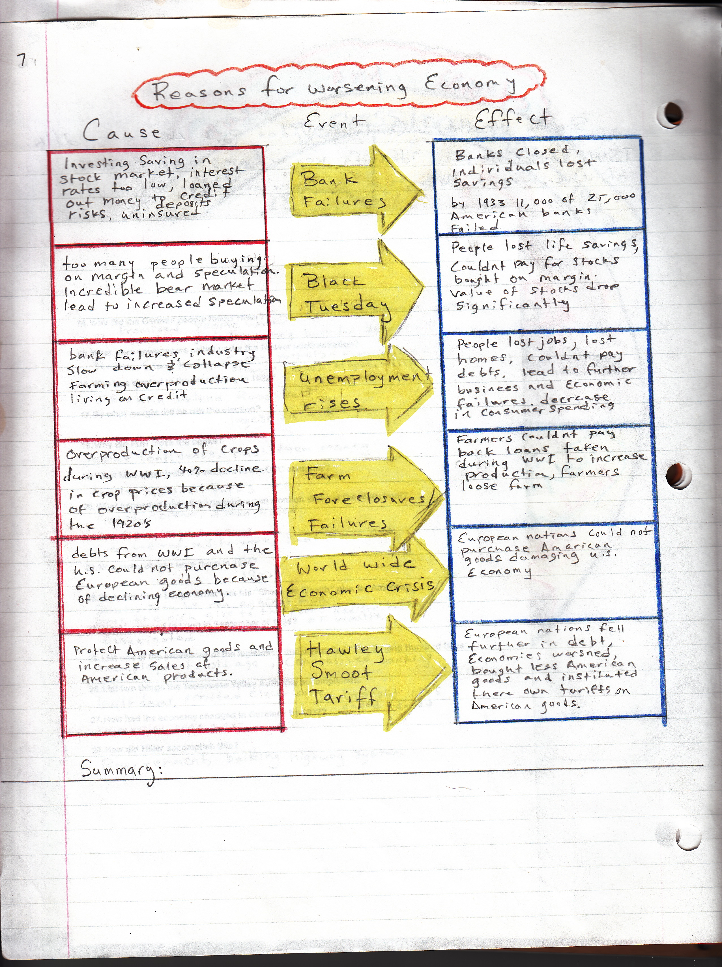
Left Side Examples

Slide 13
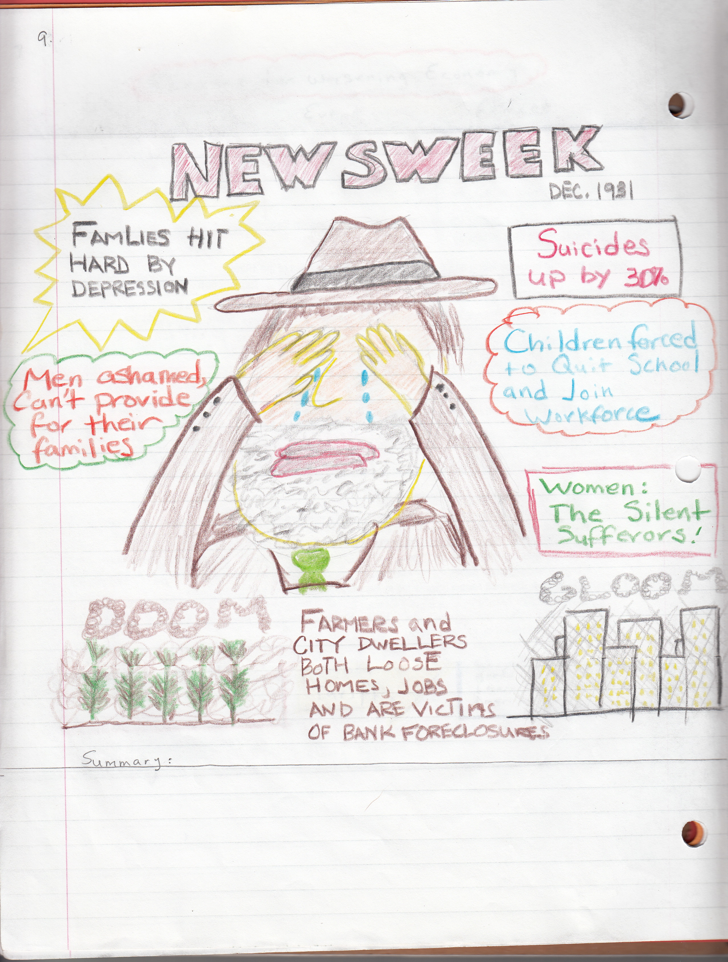
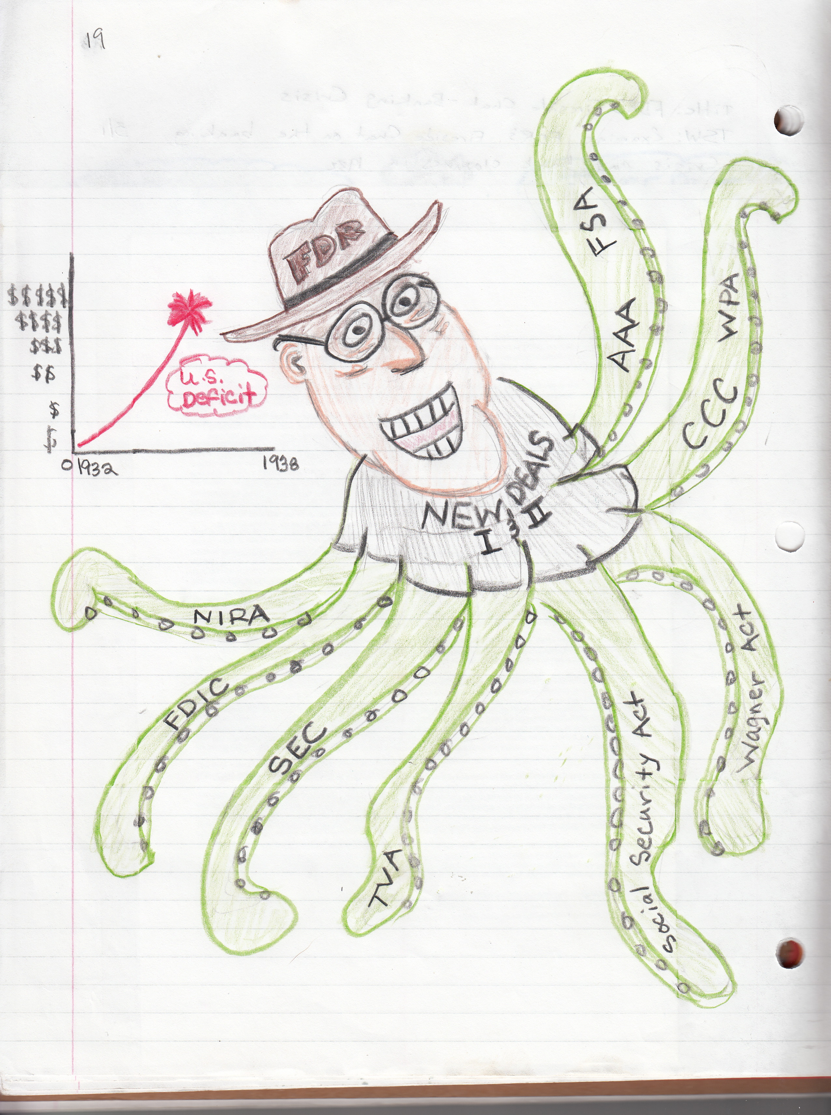

Slide 14
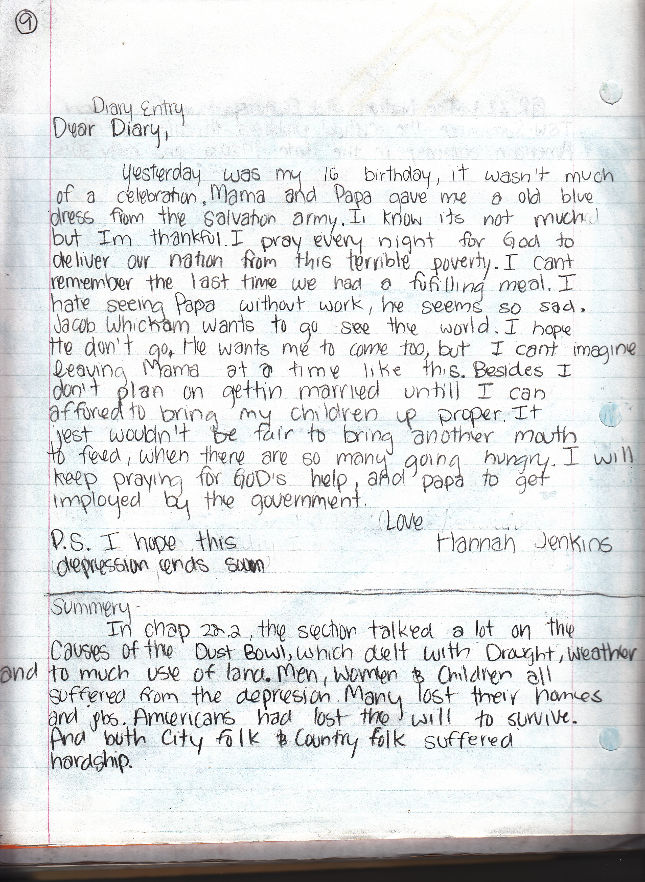

Slide 15
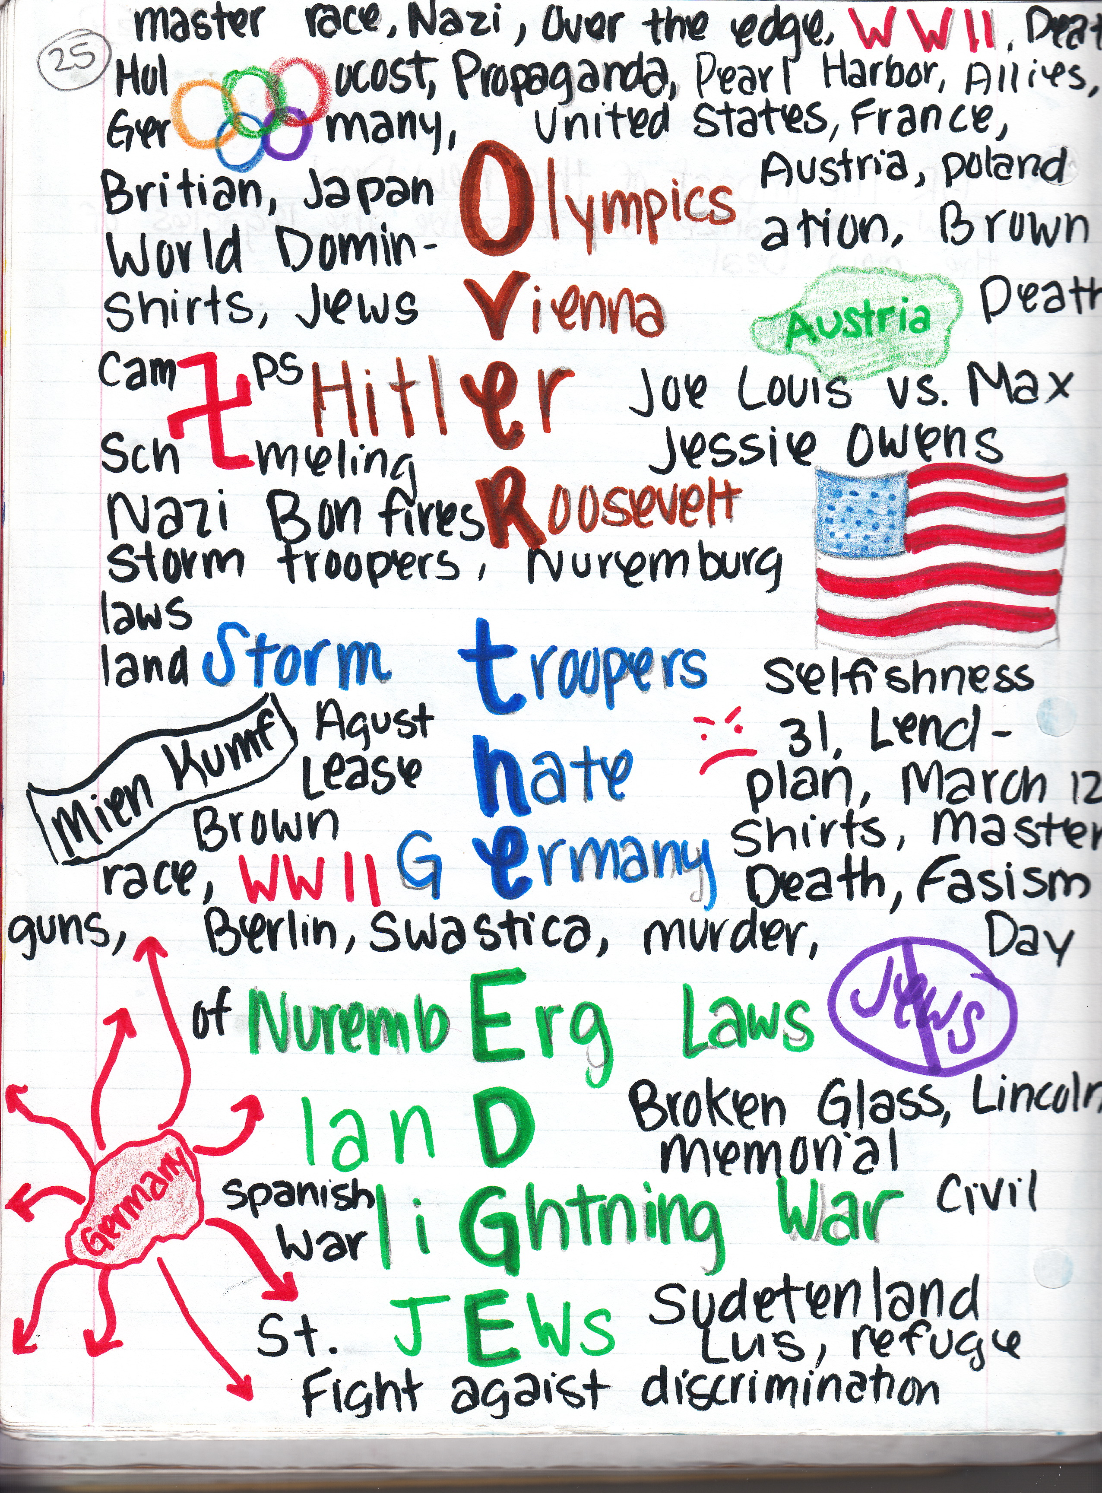

Slide 16
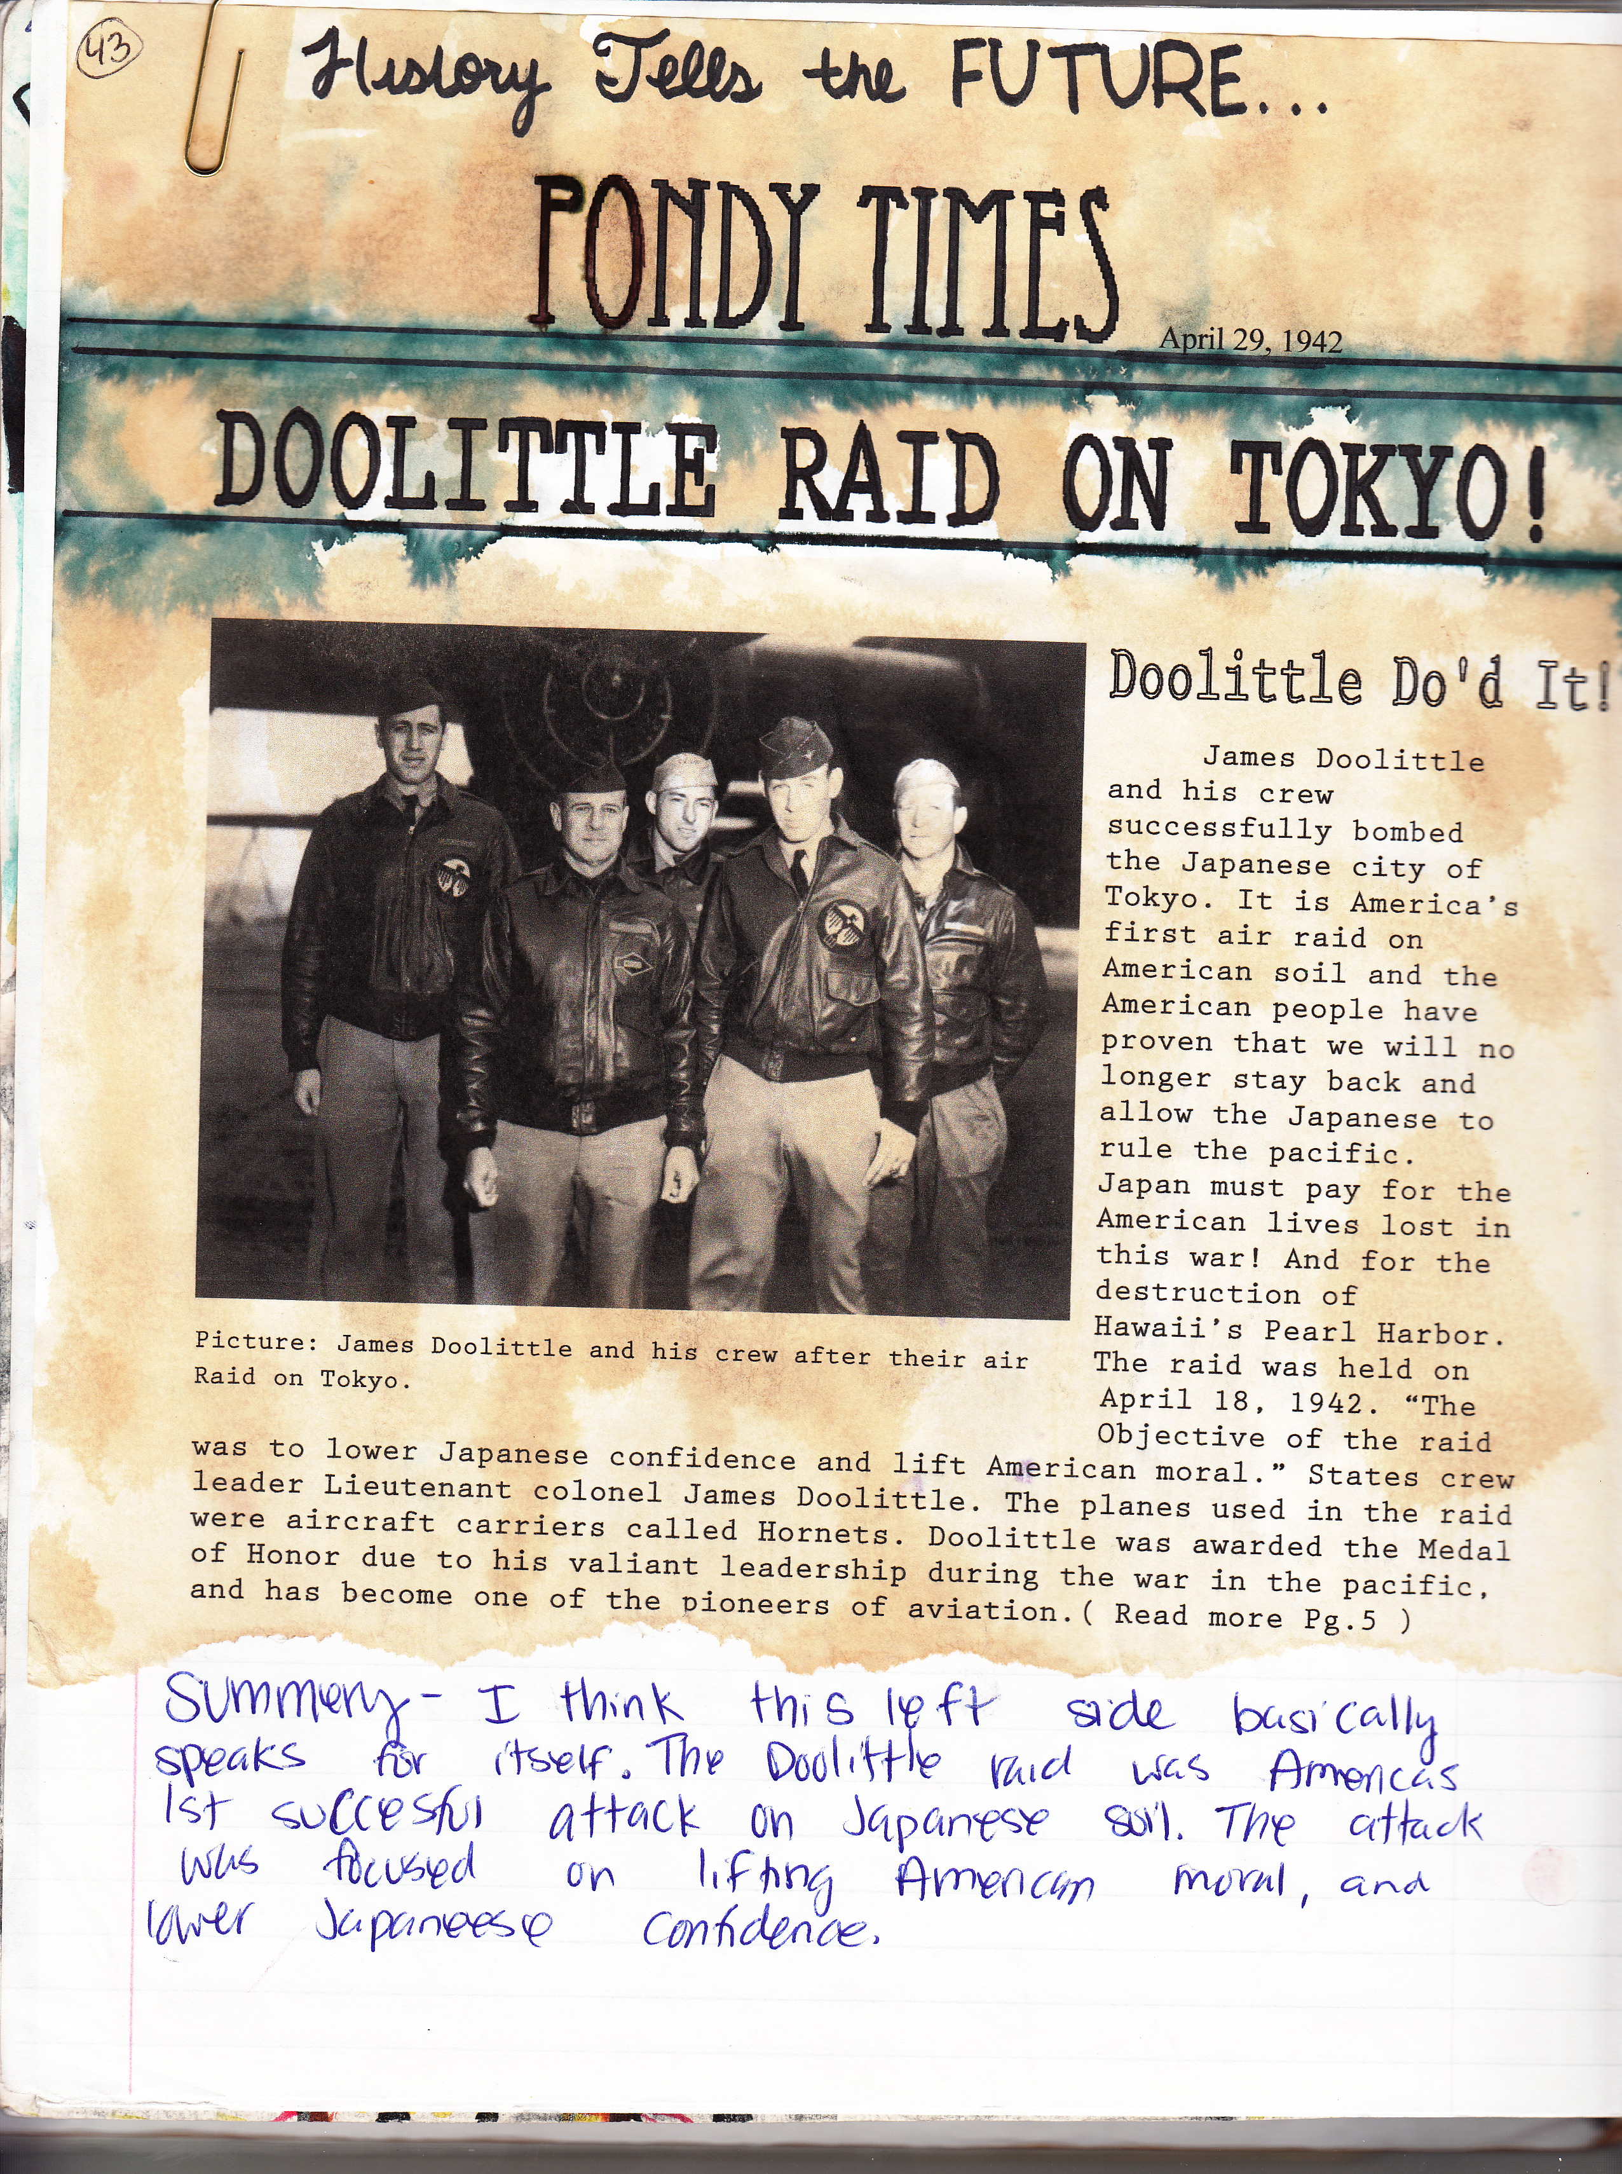
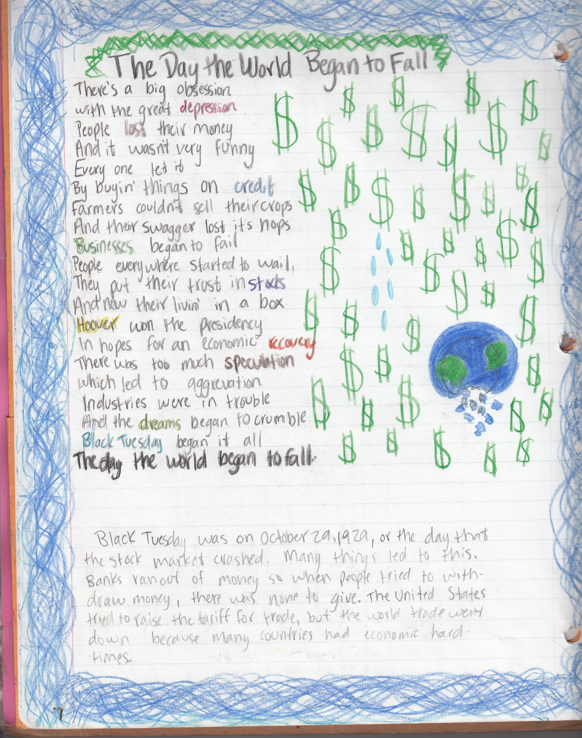

Slide 17
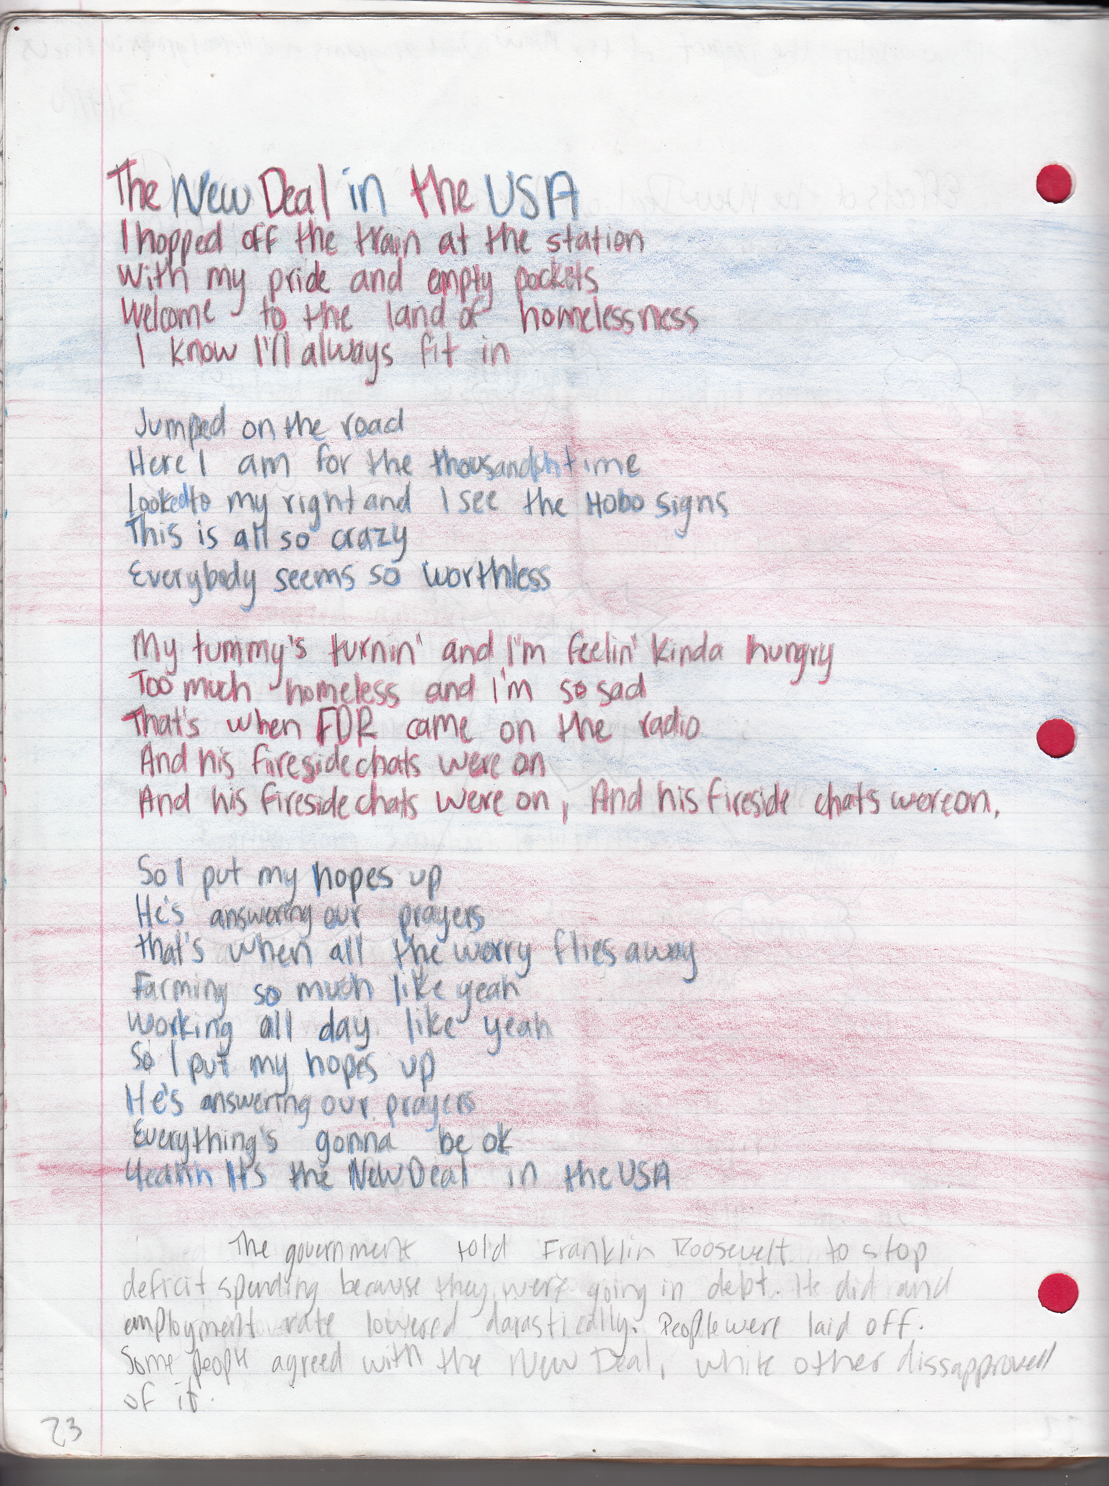

Slide 18
How is the ISN Graded
25 points for a completed right and left side as well as a thorough summary.
15 points for ISN with minor missing work
0 for an incomplete right and left side
Students may earn back partial credit if completed ISN entry is turned in within 24 hours of initial due date
May use “Life Happens” pass on ISN’s

