Slide 1
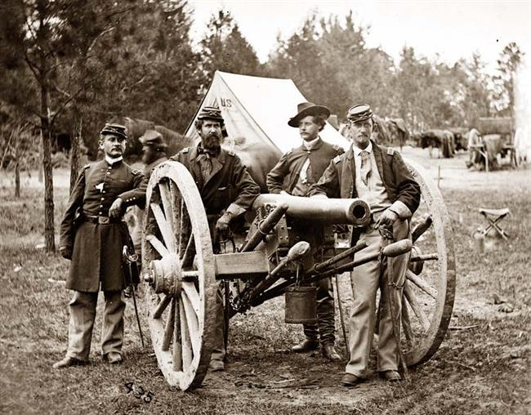
Major Battles of the Civil War

Slide 2
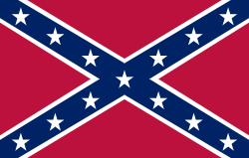
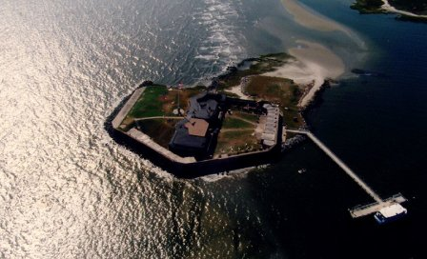
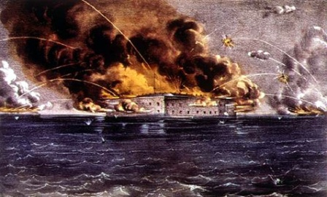
Fort Sumter April 12, 1861
South Carolina
Casualties:
None
Lincoln ordered the resupply of the fort, promised no munitions, guns or men.
First Battle of the Civil War
Fought in Charleston Harbor
Bloodless opening to the bloodiest war in American History

Slide 3
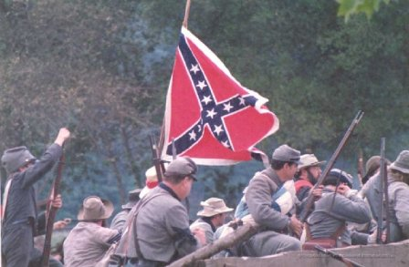
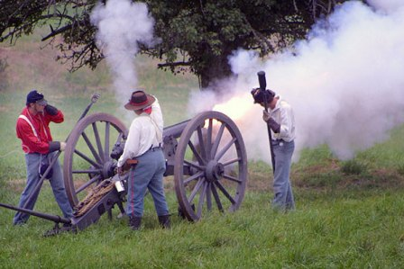
First Bull Run/Manassas July 21, 1861
Virginia
Casualties:
Union – 2,896
Confederacy – 1,982
First land battle between the Union and Confederate Armies
Confederates route the Union, panicked troops rush back to DC.
Casualties for both sides were overwhelming.
Realization that it was going to be a long war.

Slide 4
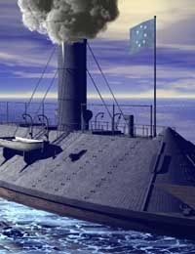
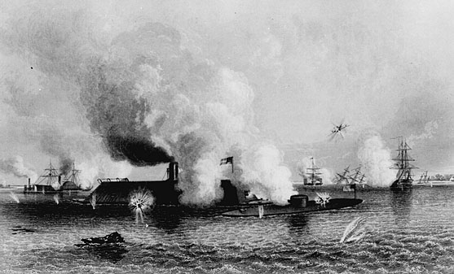
Hampton Roads March 9, 1862
Virginia
First clash of ironclad warships
Revolutionized naval warfare, made wooden navies obsolete.
Fought between the Monitor and the Merrimack (Virginia)
Ships fight all day, but the battle is a draw
Casualties:
Union – 240 & 2 ships
Confederacy - 25

Slide 5
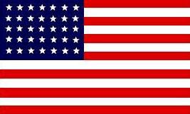
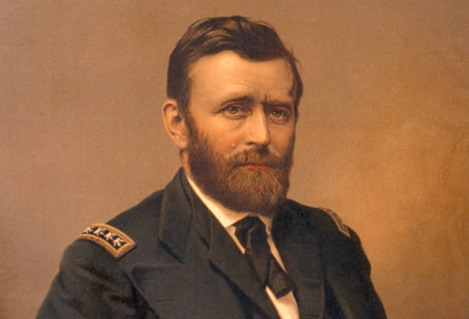
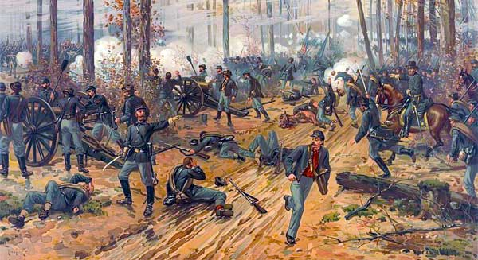
Shiloh April 6-7, 1862
Tennessee
Casualties:
Union – 13,047
Confederacy - 11,600
First battle with huge casualty numbers.
Shiloh means “place of peace” in Hebrew.
Key victory in cutting the South in half, Tennessee was firmly under Union control.
Grant continues his campaign to Control the Mississippi River.

Slide 6
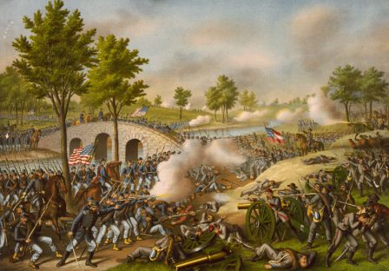
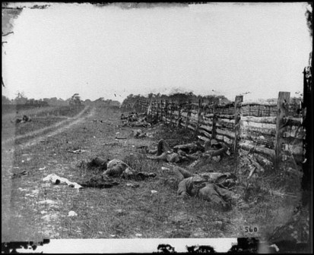
Antietam September 17, 1862
Maryland
Casualties:
Union – 12,401
Confederacy - 10,134
Single bloodiest day in American history.
Robert E. Lee’s first invasion of the North
Slight Union victory, only because they are left in possession of the battlefield.
Victory Lincoln needed to issue the Emancipation Proclamation

Slide 7
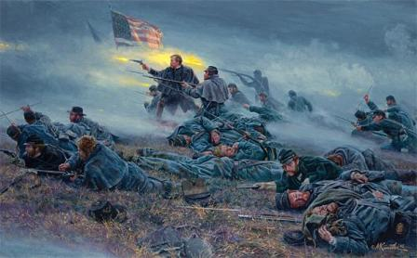
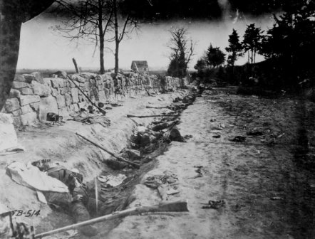
Fredericksburg December 13, 1862
Virginia
Casualties:
Union – 12,600
Confederacy – 5,300
Decisive victory for the Confederacy.
Union General Burnside chooses to make a frontal on an entrenched Confederate position, leads to a slaughter.
14 Union assaults are repelled.
Gives the Confederacy confidence

Slide 8
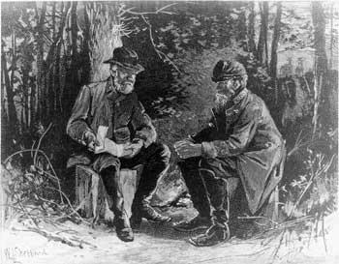
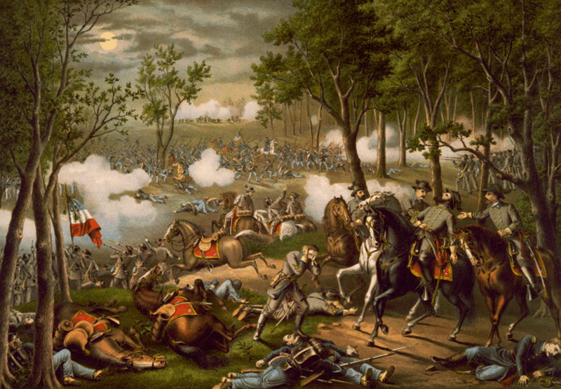
Chancellorsville May 1-4, 1863
Virginia
Casualties:
Union – 17,000
Confederacy – 12,800
Lee’s masterpiece, greatest Confederate victory of the war
Divides his much smaller Confederate Army to attack the Union from two sides.
Union is routed
Stonewall Jackson, Lee’s right hand man, is shot and killed by his own troops.

Slide 9
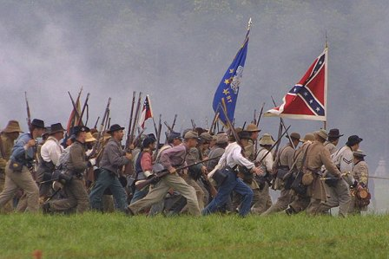
Gettysburg July 1-3, 1863
Pennsylvania
Casualties:
Union – 23,000 +
Confederacy – 28,000 +
Lee’s second invasion of the North, hoped to end the war with a decisive Confederate victory of Union soil.
Turning point of the war, the South will never invade the North again.
Three day battle, bloodiest of the war.
Little Round Top and Pickett’s Charge two most famous events of the battle.
Decisive Union vitory
Lincoln delivers the Gettysburg Address on November 19, 1863.

Slide 10
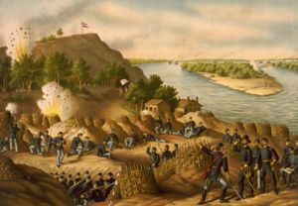
Vicksburg May 2-July 4, 1863
Mississippi
Casualties:
Union – 9,000 +
Confederacy – 9,000 +
Ulysses S. Grant lays siege to last Confederate stronghold on the Mississippi River.
Last for three months
Cuts the Confederacy in half
Falls the day after Union victory at Gettysburg.

Slide 11
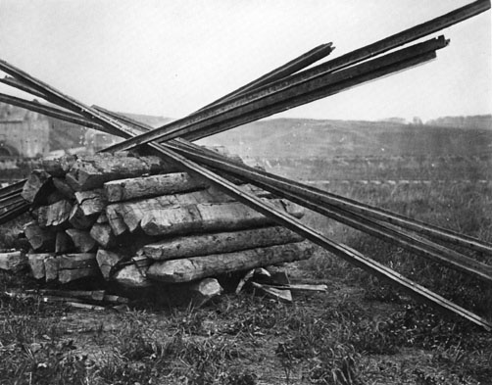
Sherman’s March to the Sea November 15-December 20, 1864
Georgia
Casualties:
Union – 2,100 +
Confederacy – 1,000 +
Begins after the siege and Union capture of Atlanta.
March from Atlanta to Savannah Georgia
Employed the policy of “Total War” and “Scorched Earth” destroying everything in his path.
Breaks the back of the Confederacy in the Deep South.
Delivers Savannah as a Christmas present to Lincoln.
Lincoln will win reelection in 1864 as the end of the war is in sight.

Slide 12
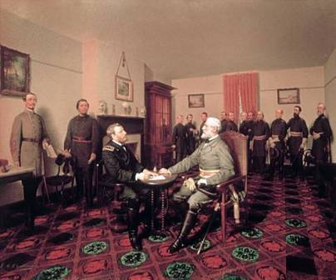
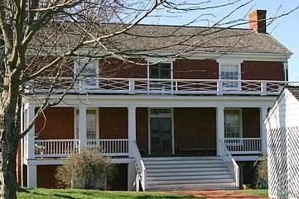
Surrender at Appomattox April 9, 1865
Virginia
Casualties:
Union – 1,312
Confederacy -8,200 – 28,231 surrendered
Battle of Sayler’s Creek
Lee officially surrenders the Army of Virginia to U.S. Grant
Effectively ends the Civil War

