Slide 1

Antebellum Introduction
1820 - 1860

Slide 2
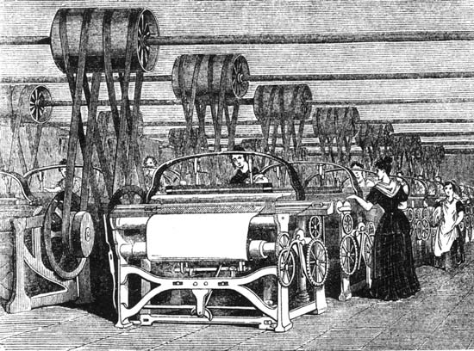
Market/Industrial Revolution
Shift from agricultural to a wage based economy.
Exchange of goods and services
Eli Whitney invented the cotton gin
Cyrus McCormick invented the mechanical reaper
Internal improvements such as the Erie Canal and the Cumberland Road
New transportation – steamboats and railroads allow easy movement of goods and people from agricultural west to industrial north.

Slide 3
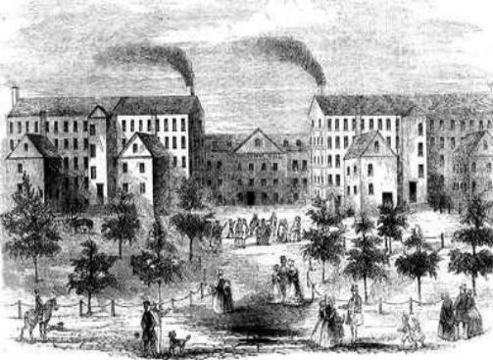
Urbanization
Americans begin to move to cities in search of jobs.
Birth of the middle class in America as a result of the wage labor system.
Reform movements to better society (reduce consumption of alcohol, eliminate prostitution, improve institutions, education, and ban slavery)

Slide 4
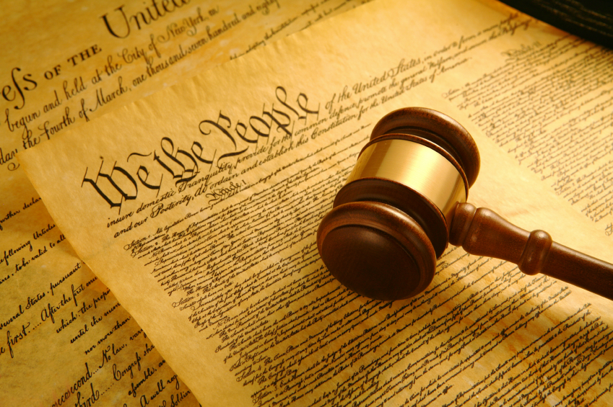
States Rights
States should have the final say in matters regarding the interpretation of the Constitution.
Southern states dominated by “states righters”
John C. Calhoun and the Nullification Crisis of 1832-33

Slide 5
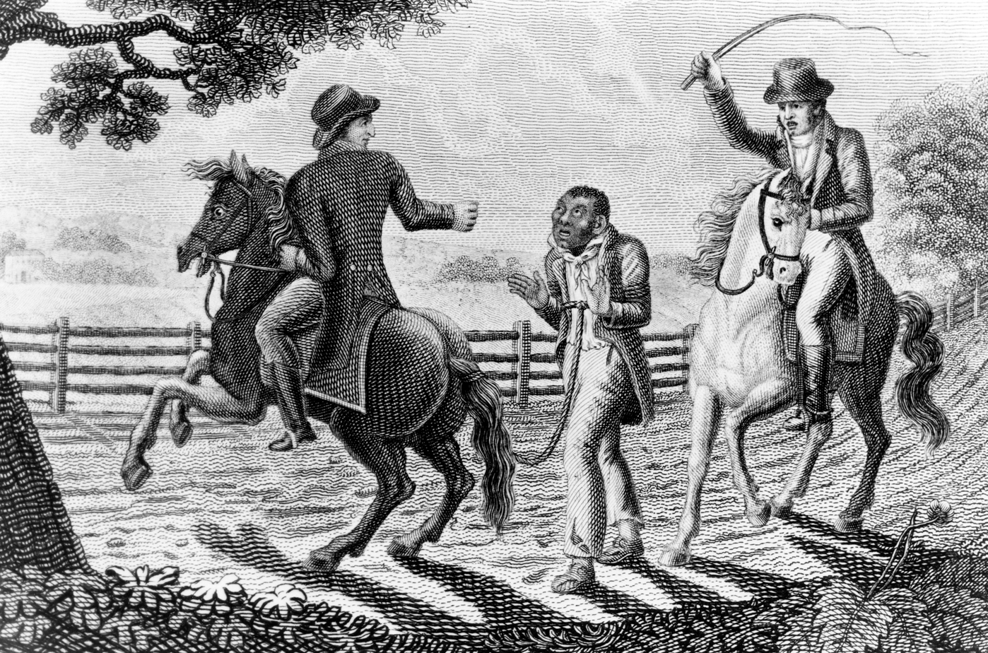
Debate Over Slavery
Most divisive issue in the nation
Northerners realize the horrors and injustices of slavery.
Southerners increasingly dependent on cotton based economy and slave labor.
Northerners not necessarily for social and political equality, just emancipation.
Debate centers on western expansion of slavery
Southerners saw expansion including slavery a necessity for their way of life.
Debate centered on areas of Missouri, Texas, and Mexican Cession.

Slide 6
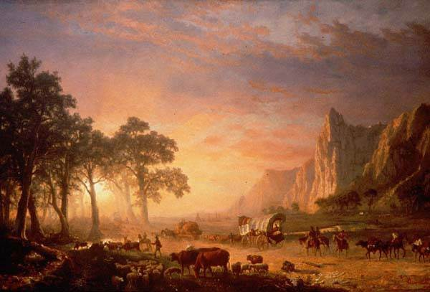
Western Expansion
Increased nationalism
Manifest Destiny – idea that the U.S. was ordained by God to expand across the continent.
Millions of Americans move west to places like Oregon, Utah, Santa Fe, and California
U.S. acquires Florida, Oregon, Texas, California, and much of the Southwest.

