Slide 1
American Imperialism

Slide 2
Reasons for American Imperialism
Closure of the frontier
Fears that natural resources would run out
Success in subjugating Native American tribes in the West.
Social Darwinism applied to world affairs
Need for new markets
Cultural superiority
Spread Christianity and democracy

Slide 3
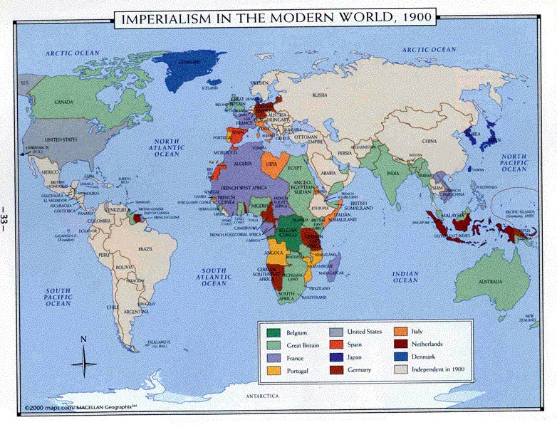

Slide 4
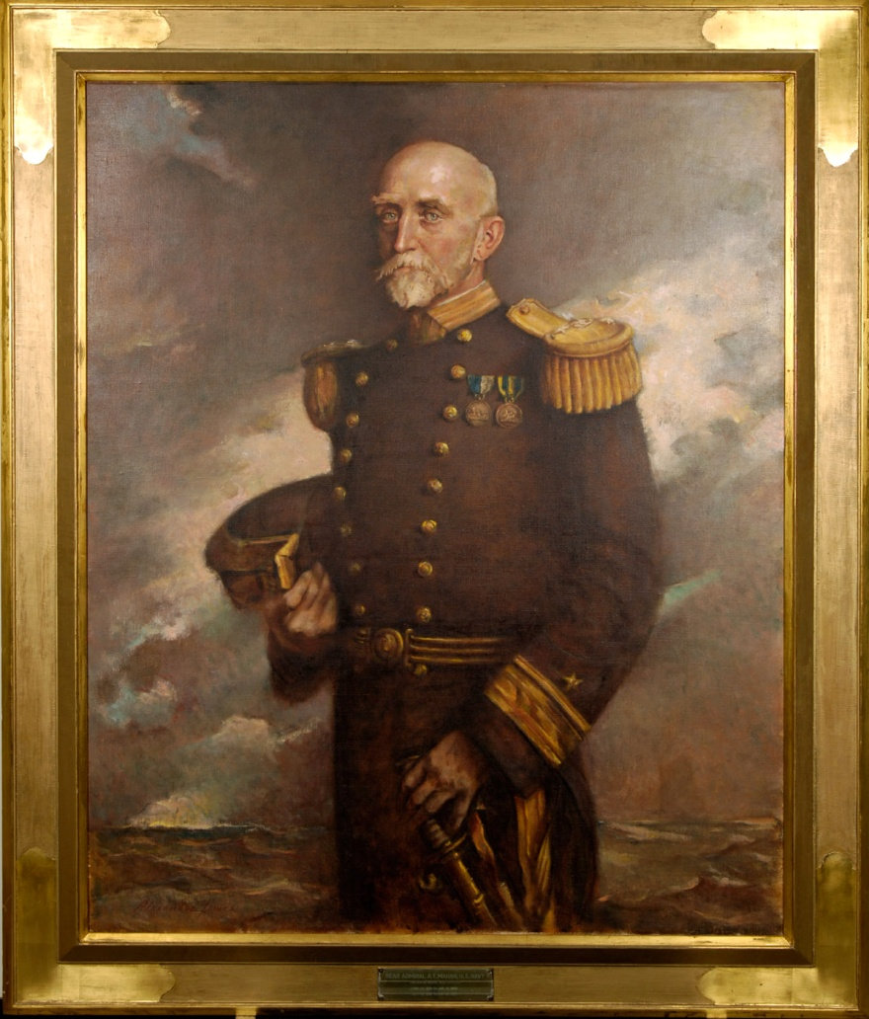
Alfred Thayer Mahan
Admiral in the U.S. Navy
Author of The Influence of Sea Power Upon History
A strong navy was key to a nations success
Therefore, the U.S. must have a strong navy
Requirements to be a sea power
Productive domestic economy
Foreign commerce
Strong merchant marine
Navy to defend trade routes
Colonies to provide markets, raw materials, and naval bases

Slide 5
Hawaii
Important to American trade with China
U.S. wanted a permanent base at Pearl Harbor, Hawaii
1887 treaty negotiated allowing U.S. to open a naval base at Pearl Harbor
Increasing American presence economically and politically in the Hawaii (missionaries and sugar planters)
Begin to buy land and establish sugar plantations
Constitutional monarchy established by King Kamehameaha III
Sugar basis of Hawaiian economy
1875 -1890 America allows Hawaiian sugar into the U.S. duty free
1891 Queen Liliuokalani elected opposed to American domination
1893 American planters stage a coupe, call on U.S. military aide, establish a provisional government
1898 annexation by the U.S. occurs

Slide 6
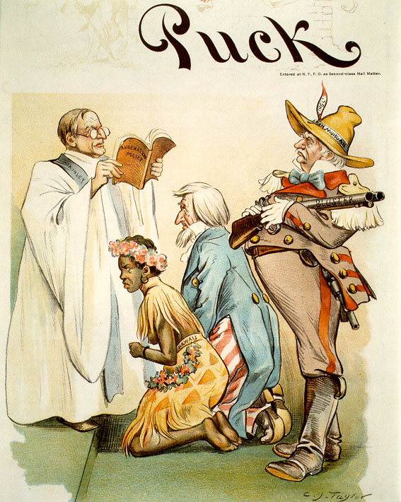
Uncle Sam weds an unhappy Hawaii as President McKinley officiates the services reading from the book “Annexation Policies”. Alabama Senator John Tyler Morgan, a strong supporter of Hawaiian annexation, stands proudly behind the couple holding a shotgun.

Slide 7
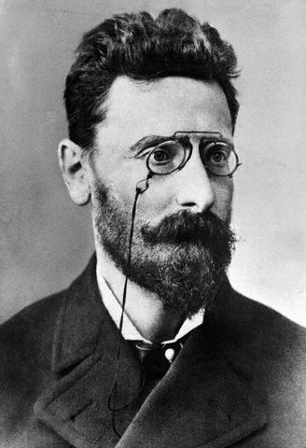
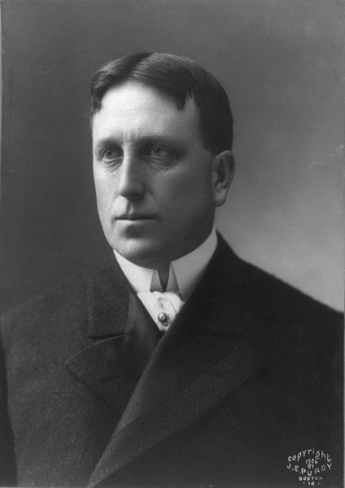
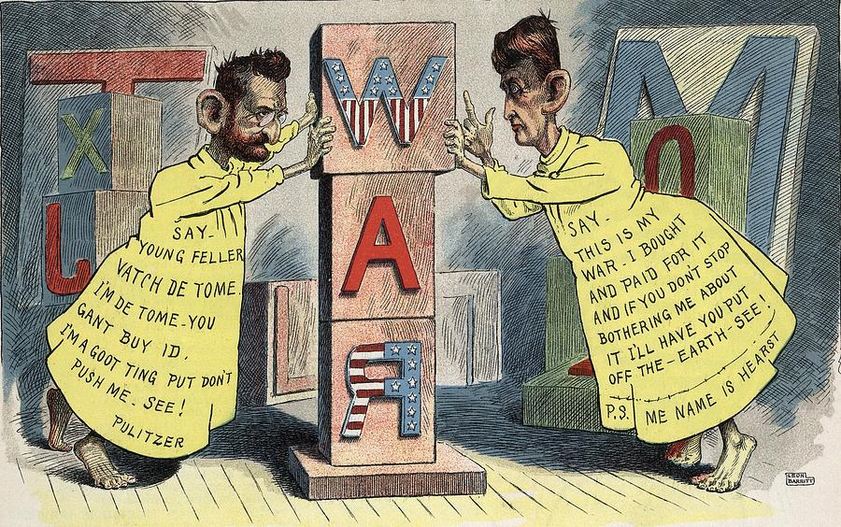
Yellow Journalism
Joseph Pulitzer editor of TheWorld
William Randolph Hearst editor of the New York Journal
Use of sensationalized (often false) news stories in order increase readership and circulation

Slide 8
Tensions with Spain in Cuba
1895 Cuban insurectos rebel against Spanish rule.
Spain sends General Valeriano Weyler to quell the uprising
Known as “Butcher Weyler”
Establishes concentration camps with brutal conditions
Hearst and Pulitzer send journalist to write about atrocities
Americans respond with growing concern and outrage
McKinley officially protests Spain’s “uncivilized and inhuman” conduct.
Spain withdraws Weyler fearing American involvement and loosens its policies on Cuba.
DeLome Letter – Dupuy de Lome was a Spanish minister in Washington, writes a letter describing McKinley as weak and spineless. Americans are outraged.
Battleship Maine blows up in Havana Harbor while on a humanitarian mission.
260 American sailors killed
Spain immediately blamed, later discovered that it was an accidental explosion in one of the ships engine rooms.
Hearst “You provide the pictures, I’ll furnish the war”
March of 1898 U.S. declares war on Spain even though an armistice had been reached.
Spanish American War, AKA the “Splendid Little War”

Slide 9
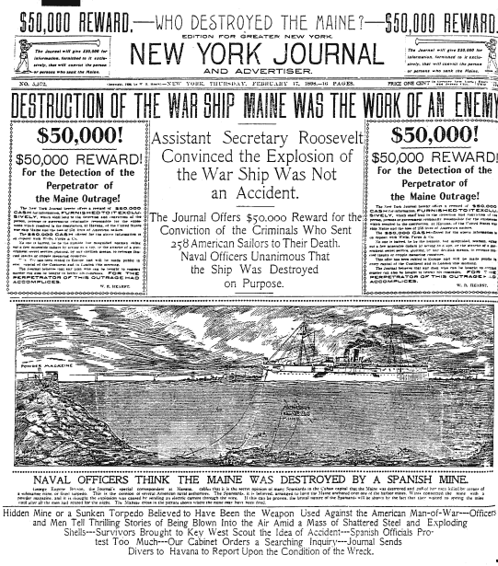
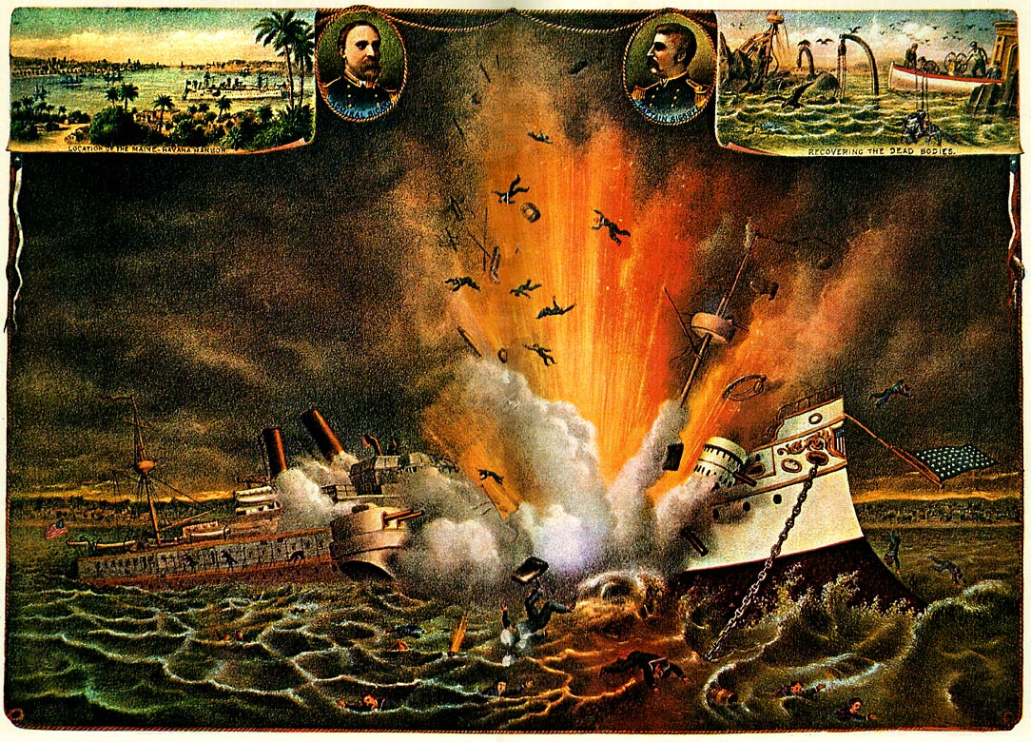
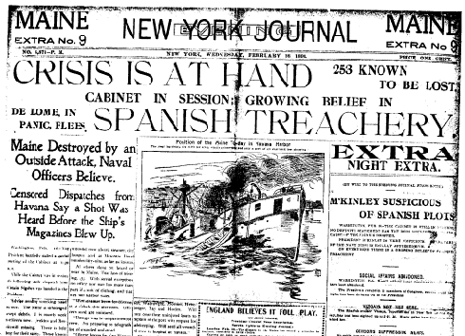
“Remember the Maine!”

Slide 10
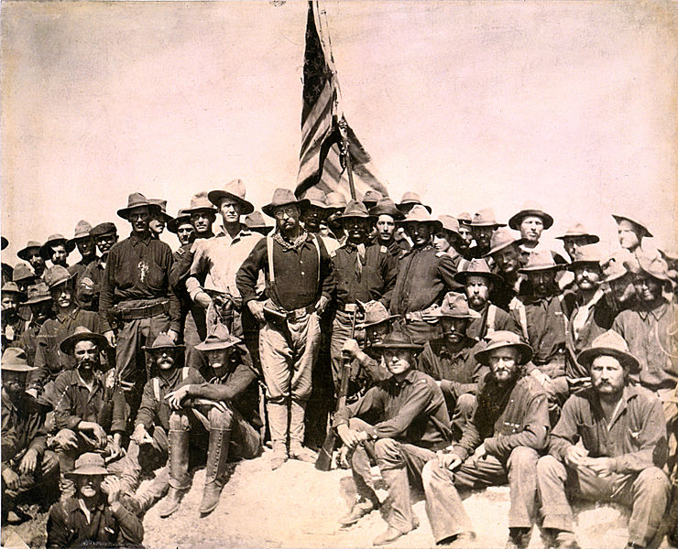
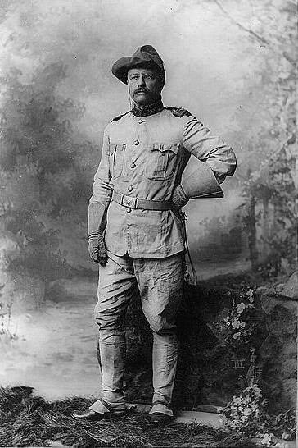
Teddy Roosevelt and the Rough Riders

Slide 11
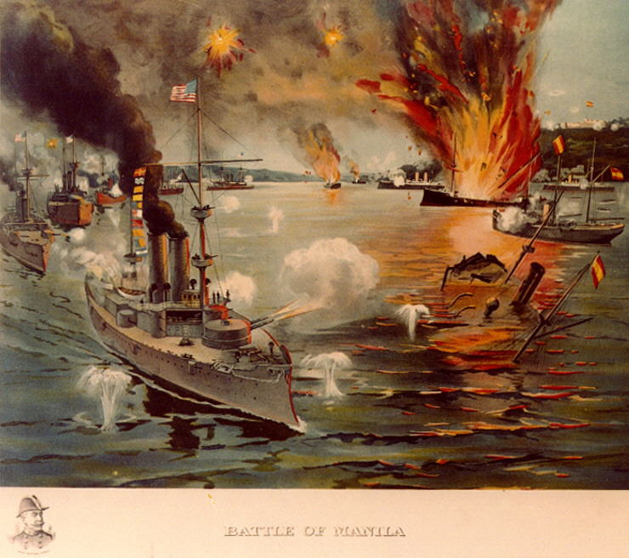
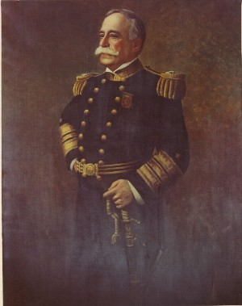
Seizing the Philippines
Theodore “Teddy” Roosevelt was assistant secretary of the Navy
Saw the easy opportunity to take the Philippines from the Spanish
May 1, 1898 The American fleet, under the command of Commodore George Dewey, sailed into Manila Harbor and destroyed the Spanish navy.
Spanish government surrenders and America takes control of the Philippines.

Slide 12
Results of the Spanish American War
Spanish recognize the independence of Cuba
Puerto Rico and Guam ceded to the U.S.
1917 Jones Act passed by Congress declaring Puerto Rico as an official territory of the United States and made all Puerto Ricans American citizens.
Continued American occupation of the Philippines

Slide 13
Cuba After the War
America promised Cuba independence after the war was over (Teller Amendment)
Platt Amendment
Forbid Cuba from making treaties with other nations
Gave America the right to intervene in Cuba to preserve life, liberty, and property
Required American access to naval stations in the territory
Cubans disliked “Yankee Imperialism”
Minor revolts requiring intermittent U.S. military intervention
Americans pour into Cuba purchasing up plantations, factories, railroads in and refineries
Sugar becomes the dominate product exported from Cuba

Slide 14
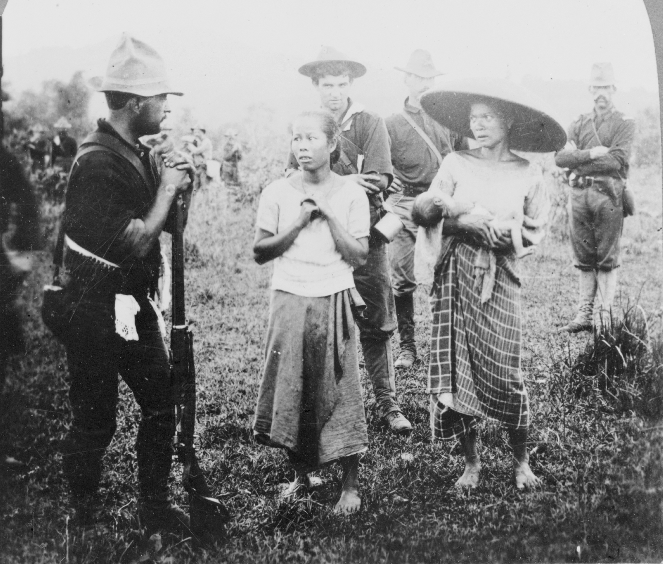
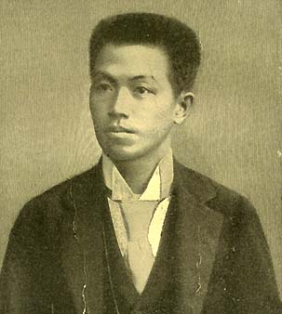
The Philippine War
1898 – 1902
4300 Americans killed, more than 50,000 Filipinos
Filipino rebels led by Emilio Aguinaldo
Americans used systematic and brutal tactics against the enemy and civilian populations
Viewed the Filipinos in many cases as “subhuman”
March 1901 Aguinaldo is captured
Encourages fellow Filipinos to surrender
1901 William Howard Taft takes over as governor of the Philippines
Philippines become dependent on American goods
July 4, 1946 Philippines become an independent nation

Slide 15
Open Door Notes
America was concerned with keeping trade with China open
England, Germany, France, Russia, and Japan beginning to carve up China
John Jay’s plan to keep trade with China open
Each nation would respect the rights of other nations to trade with China
Chinese officials were to continue collecting tariffs
No discrimination of railroad and port dues by any nation
“fair competition”

Slide 16
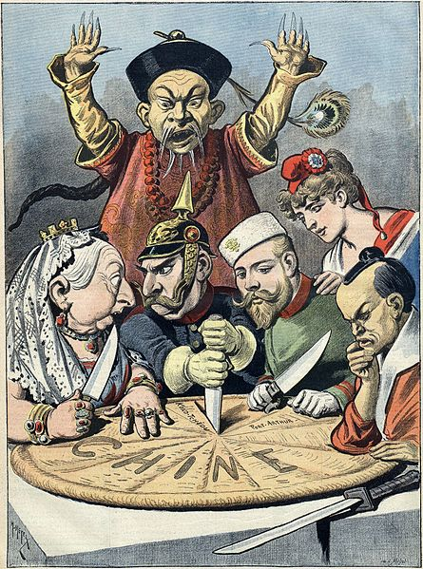
Boxer Rebellion
Boxers (secret Chinese martial arts society) attempt revolt against foreigners
U.S. and other nations send forces to put down the revolt
The rebellion fails, U.S. claims victory and ensures that China is not divided by imperialist nations.
Open Door Policy established, U.S. trade interested protected.

Slide 17
